Slide 1




Modern College of Engineering MCA Department
CRYPTO PRICE FETCHER
Progressive Education Society's
FYMCA-Sem-II(Term-II)
Rajat Bhargav 51106
Madhumita Sarkar 51153
Swarup Sharma 51154
Manjeet Kumar Singh 51157
Name of Project Guide : Prof. Rama Bansode
Academic Year- 2021-22 (Term-II)

Slide 2

Contents
Project Introduction
Need of the system
Scope of the system
Requirement of the system
Flow Diagram/Flow chart
Use case diagram
Screen layouts
Report
Limitations & future Enhancements

Slide 3

Project Introduction
Crypto Price Fetcher is an android application which is developed with Java on Android Studio with Volley library support.
This android application displays different crypto-currencies and their details.
Application main intent is to fetch current price of crypto-currencies for the user's

Slide 4

Need of the system
As per the technology is changing everyday rapidly and cryptocurrency are the new asset which is trending and future of digital currencies as it is secure safe and also used for trading as investments there are many other advantages of crypto-currencies based technology ( for example :- NFT's, Blockchain )
By using this application one can get the latest cryptocurrency price update by which user can use this information for trading, investment etc.

Slide 5

Scope of the system
We can speculate on what value cryptocurrency may have for investors in the coming months and years (and many will), but the reality is it’s still a new and speculative investment, without much history on which to base predictions. No matter what a given expert thinks or says, no one really knows.
As internet is getting cheaper, it’s become easy to access anything and which makes trending topics more trending and investments are so easy nowadays , If you check the graph after pandemic people are very aware of investments and future and they see crypto as a good source of wealth in future and even now also
So scope for digital asset or cryptos are very broad in future.

Slide 6

Requirement of the system (H/W and S/W)
As the technology is growing everything is becoming easier, small and compact, as our project is an android application it has less requirements
Technology used : - Java , Volley library, API - CoinMarket( for fetching crypto prices)
Requirements :-
Smartphone with android version > 5.0
Internet connection

Slide 7

Flow Diagram/Flow chart
DATA
\\// API
(SERVER)
Cryptos Price
Backend Connection established
Updates

Slide 8

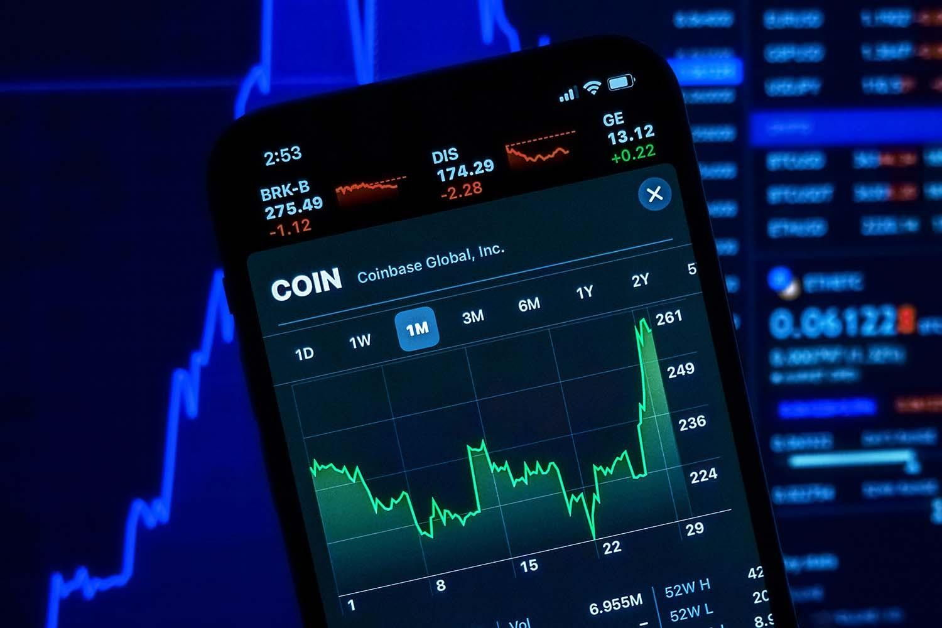
Use case Diagrams
This can be useful for many things but there are two major thing : -
CryptoMarket ( Trading / Investments) one can check the crypto curencies price .
Crypto Miners – Miners always prefer to mine coin which has good value so in order to making mining profitable and effective he has to be updated with the prices of crypto curencies

Slide 9

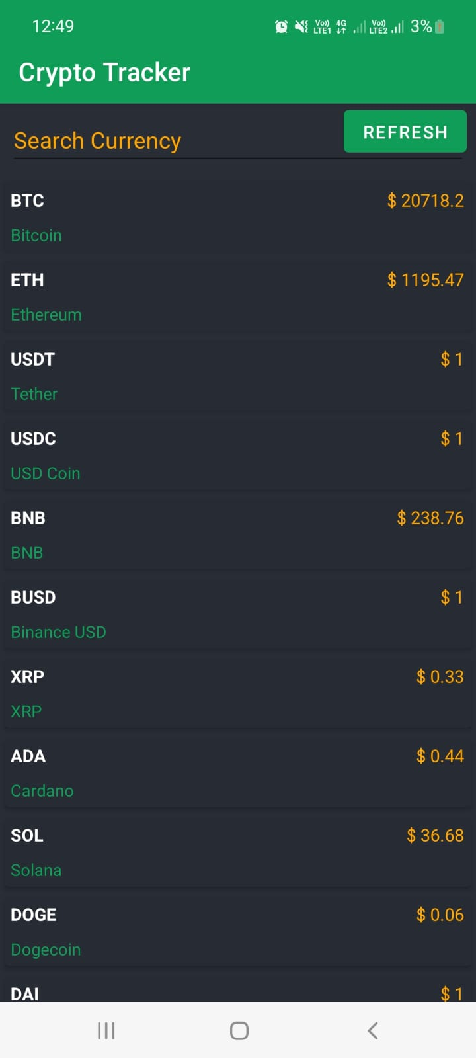
Screen Layouts
Home Screen
First Screen consists of different type of crypto-currencies with its price getting updated regularly.

Slide 10
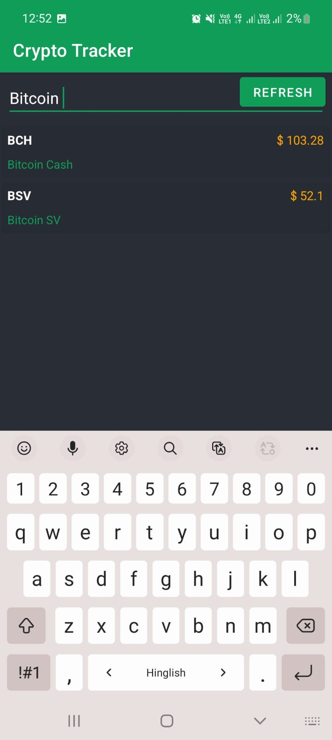
Search Bar ( use to filter coin)
At top of the Home Screen Search Bar will be used to filter coin as per user requirement

Slide 11
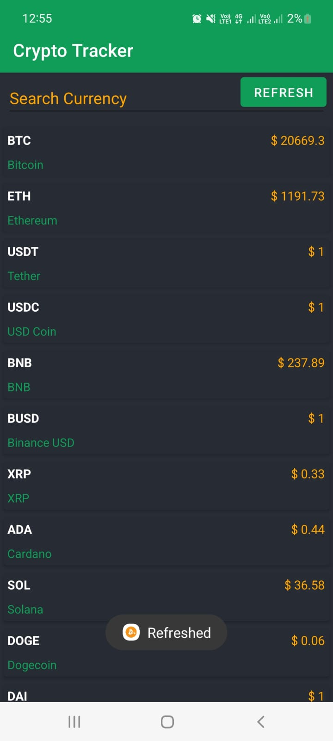
Refresh Button
Updates the Crypto Coin Prices -
By calling request to
API(CoinMarket)

Slide 12
Reports
Project name : Crypto Tracker
Technology used : Java , Volley Library , Android Studio , JSON
Requirements : Internet Permission , Android version > 5.0
API ( CoinMarket) - Free version
We have build a simple application in which we will be displaying the real-time rates of different cryptocurrencies inside our app
features :-
Search bar , Refresh Button , Recycler View (Screen Type)
Application Size : - 4.5 mb

Slide 13
Limitations & future Enhancements
Limitations :-
As the API used in this project is free therefore the API request per day is limited .
Time band of API request is fixed for free version.
Future Enhancements :-
Paid API can be used for subscription base API Request hence the limit of request will be incremented

